Slide 1
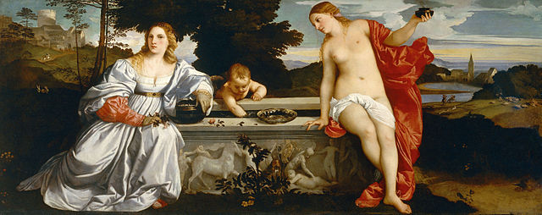
History 336
Ideas and Society in Early Modern Europe:
The Debate about Gender and Identity

Slide 2
Questions for 6 February
What passages from the reading assigned for today strike you as historically significant?
What should unmarried women do and not do?
For each chapter, consider the following questions: What is Vives’ goal? What rhetorical strategies does he pursue to achieve that goal? What sort of evidence supports his goal?
What role does the Virgin Mary play in Vives’ advice for women?

Slide 3
Questions for 6 February
Imagine that you are an early modern educated woman like Margaret Roper or Anna Maria van Schurman. How would you respond to the specific assumptions and arguments he makes about women?
How would you characterize Vives? How would you assess him historically?
Can you formulate at least one historical question based on the assigned reading to start a larger discussion?

Slide 4
In the news
The Telegraph, 6 February 2013, “Syria: the former English teacher turned Aleppo’s female sniper” http://www.telegraph.co.uk/news/worldnews/middleeast/syria/9845535/Syria-the-former-English-teacher-turned-Aleppos-female-sniper.html
BBC, 5 February 2013, “The Indian women pushed into hysterectomies” http://www.bbc.co.uk/news/magazine-21297606

